Slide 1
Meaningful UX with Graph Data
Notes:
OK, this presentation is probably going to be a little different
This talk is going to be from the prospective of a UX designer
* Today we’re going to talk about what comes after you’ve stand up graph database
* And it’s time to develop a solution that exposes that data to an end user
We’ll cover everything from graph visualization to standard UX best practices from the prospective of a UX designer

Slide 2

Hello!
Chris LaCava
Senior UX Designer
Expero www.experoinc.com
Chris has spent the past two decades defining, designing and building software for a variety of industry verticals. He has experience as a usability engineer, interaction designer, front-end developer as well as product manager for both consulting and product-oriented organizations.
Notes:
Who am I?
My name is Chris LaCava, I’m a Senior Software Designer at a Consulting Company called Expero Inc
I’ve also worked as a Product Manager, a Usability Engineer, a Front end developer, as well as founded a couple of startups

Slide 3
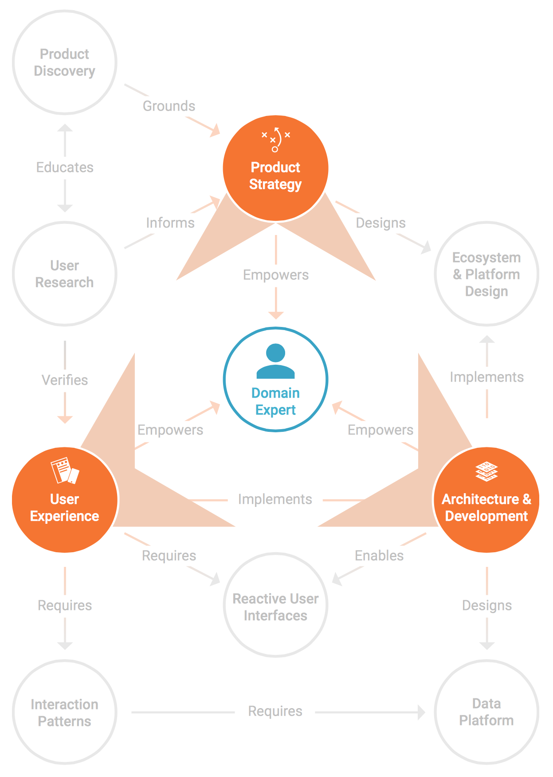
Bringing Challenging Product Ideas to Life
Data Architecture, Visualization & Training
Reactive User Interfaces
Lean Product Discovery & Rapid Prototyping
Productizing Research & Innovation Projects
Custom Software for Scientific Computing
Data Science & Machine Learning
Notes:
*As I mentioned, I work for a company named Expero,
Specializes in bring Challenging Product Ideas to life,
More and more often that means Big Data, especially Graph
Our architecture and development team is well established in graph, many of you may have heard of our work there(Tinkerpop), but to us, graph is not just a backend technology

Slide 4
Things we’ll cover
Graph Basics
Tailor experiences to the intended audience
Determining the right visualization
Choosing the right tools
Notes:
Show of hands, how many people are familiar with Graph data?
How many people are actively working on a project that involves a graph database?
How many people here are UX designers? Do you know what the chief UX complaint is? Performance, data doesn’t go back and forth fast enough.
So in a sense everyone that designs aspects of a software application designs the UX.
User centered design is as much a philosophy as it is a discipline and I’ll show you the process that I employee,
we employee at Expero, to inject that user centered design philosophy into graph solutions we design and develop
We’ll briefly go over the basic concept of a graph to help orient everyone then we’ll jump into the UX aspects of the talk

Slide 5
Graph Basics

Slide 6
Things are connected to other things
Vertex
Edge
A
B
Node
Relationship
Notes:
At it’s simplest, a graph is a group of nodes connected by some kind of relationship. These are also referred to as vertices and edges

Slide 7
Things are connected to other things
Vertex
Edge
A
B
Node
Relationship
NYC
connected by rail
Boston
Notes:
That could be geographical nodes

Slide 8
Things are connected to other things
Vertex
Edge
A
B
Node
Relationship
Jason
son of
Alice
Notes:
It could be familial

Slide 9
Things are connected to other things
A
B
(Product)
(Franchise)
Spider Man Lunchbox
part of
Marvel
Notes:
It could be business oriented

Slide 10
Things are connected to other things
Marvel
Spider Man
Lunchbox
B
(Franchise)
part of
A
C
Ages 3-8
(Product)
recommended
(Age Range)
Notes:
Most importantly, it could be multi-faceted

Slide 11
Things are connected to other things
B
Iron Man Toothbrush
part of
Marvel
part of
Spider Man
Lunchbox
(Franchise)
(Product)
A
C
D
(Product)
recommended
recommended
Ages 3-8
(Age Range)
promoted product
Back To School 2016
E
(Promotion)
Notes:
And it almost always gets complicated, quickly.
This makes it hard for traditional technology to accommodate
And a challenge for software users (and builders) to conceptualize

Slide 12
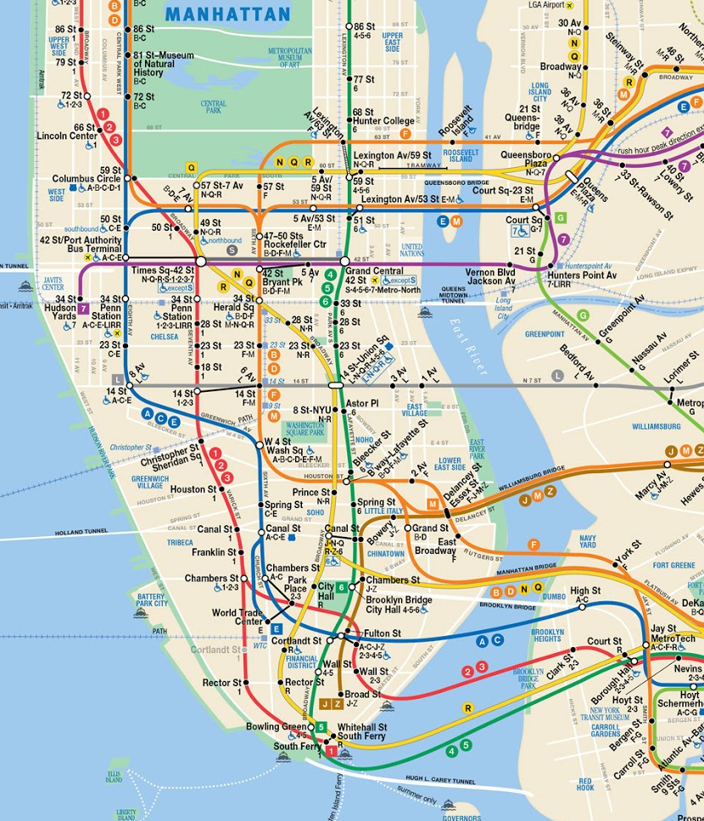
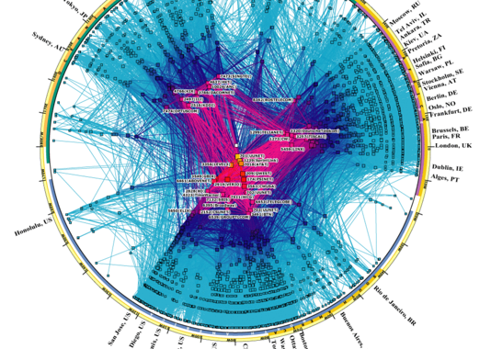

Graphs are everywhere
Transportation
Vertices Stations Cities
Edges
Rails Roads
The Internet
Vertices Routers
Computers
Edges
Fibre Ethernet Microwave
© 2016 Expero. All Rights Reserved
Notes:
Graph patterns occur in our everyday lives all the time

Slide 13
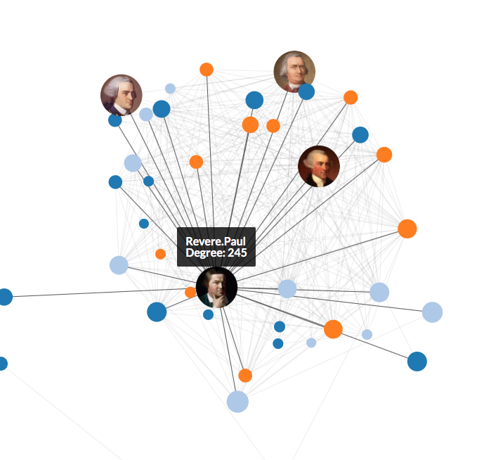
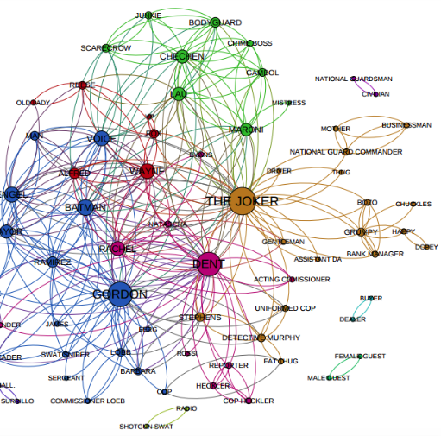
Graphs are everywhere
Social Network
Vertices
People
Businesses
Clubs
Edges
Phone Calls
Emails
Memberships
Friendships
Interactions
Professors, Papers, Conferences, Classes, Students
People, Restaurants, Hotels, Reservations, Proximity Sensors, Visits
People, Jobs, Titles, Companies, Careers, Skills
© 2016 Expero. All Rights Reserved
Notes:
They’re the natural order of human interaction,
so naturally, systems that model those interactions should often leverage them

Slide 14

Tailoring experiences
Know the problem you're trying to address
Know the goals of your users
Experience the data before you design a solution
Notes:
3 rules:
know the problem
know what your users want to do,
and understand experientially, what your data looks like (I mean really get in there and traverse it) <- this is particularly a gotcha for graph
Seems simple right:
But show me an unsuccessful graph design and I’ll bet it went wrong somewhere related to one of these 3 points
Example: I’ve seen beautiful UI designs unable to scale or support the supplied data model because the designer didn’t know the data well enough, common mistake

Slide 15
State the problem
Find the gap
Problem statement should:
“If I were given one hour to save the planet, I would spend 59 minutes defining the problem and one minute resolving it.”
Albert Einstein
Be concise and general
Identify a major gap or deficiency in current system or process
Problem statement should not:
Contain the solution
Nest other problem statements
Address only symptoms
Notes:
First step, state the problem you are trying to solve clearly and concisely, and get all stake holders on the same page. Don’t get bogged down here treating symptoms, get to the root causes.

Slide 16

Zeroing in on user goals
What users think will bridge the gap.
Goals should be:
Measurable
From the perspective of each user type
Directly address the problem
Goals should not be:
Technology specific
General, vaguely subjective
Notes:
Once you know the problem space,
Figure out what your user want to do, document it and make it measurable. This is going to define success and lead to increased user adoption.
We’ll come back to this guy on the right a little later

Slide 17
Data Discovery
How can data bridge the gap?
Dominant Dimensions provide an intuitive and technically feasible way to efficiently move through a large amount of data.
Improving data coverage also increased the probability of finding relevant relationships that might have otherwise gone undiscovered.
What’s the Dominant Dimension in your data?
Temporal
Frequency (Velocity)
Quality (Veracity)
Relationships (Connections, Correlations, etc.)
Context
Type (Variety)
Size (Volume)
State/Status
Georeference (Location)
Custom Attributes
Notes:
Understand the structure of your data. Once you know what your users want to do,
zero in on the dimensions that matter, the dominant dimensions,
They define how you’ll ultimately design your software, they’re the sign posts that guide your user to what we call “successful completion of task” in UX biz

Slide 18
The right visualization
Determine the most effective visualization
Factor in user perspective
Leverage dominant dimensions
Notes:
This is why you’re here, we’re getting to the good stuff:
So we know the problem, we’ve got the data, we know what users want to do with it,
HOW are we going to show it and allow our users to explore it?

Slide 19
Determine the most effective viz
Answer 2 Questions:
Is my information conceptual or data-driven?
Are my visuals meant to be declarative or exploratory?
Good Charts by Scott Berinato
Notes:
We need to answer 2 simple questions:
Is my information conceptual (qualitative) or data-driven (quantitative)?
Am I trying to declare (prove) a known quantity or am I trying to uncover things I don’t know yet?
Your answer can be mixed, indicating a heterogeneous user experience
citation

Slide 20
Determine the most effective viz
Declarative
Idea Illustration
Shows process or framework
Simple metaphorical
Used to simplify complexity
Standard Data Visualization
Conventional, static
Structured, simple data
Used to affirm or set context
Conceptual
Data Driven
Idea Generation
Validate ideas
Creative, free flowing
Used to wireframe / design
Data Exploration
Trend spotting, deep analysis
Network diagram, 3D+
Used for trend spotting, deep analysis
Exploratory
Notes:
***This is where UX and data visualization come together
The answers to the questions plot the solutions into 4 quadrant

Slide 21
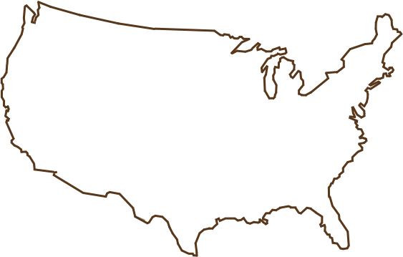
Determine the most effective viz
Declarative
Idea Illustration
Standard Data Visualization
START
STEP 1
Q?
Conceptual
Data Driven
Idea Generation
Data Exploration
SUBMIT
Exploratory
Notes:
Idea Illustration think: flow diagram or org chart Idea Generation think: whiteboard or wireframes
Standard Visualization: Think Histogram or pie chart
Data Exploration, the stuff of data science, think node chart or 4d topography
One thing to note: Graph data does not always equal data exploration. Sometimes exposing your users to that much complexity is the wrong thing to do.
So let's go through these quadrants in a little more detail

Slide 22
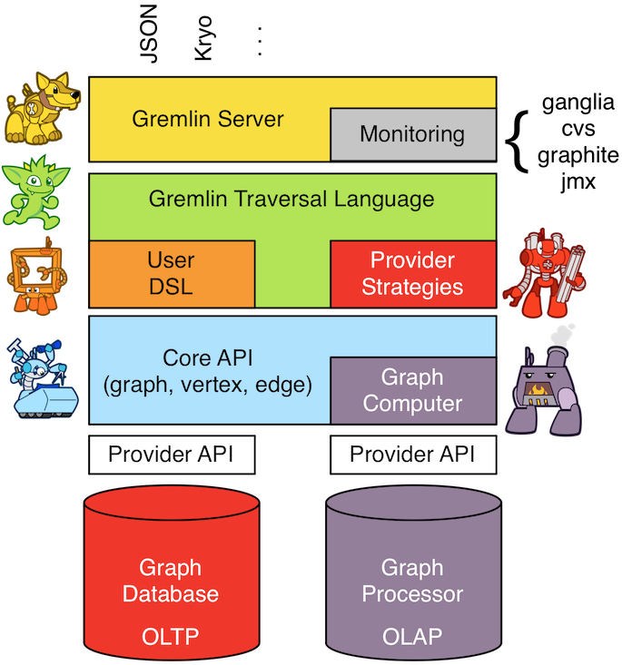
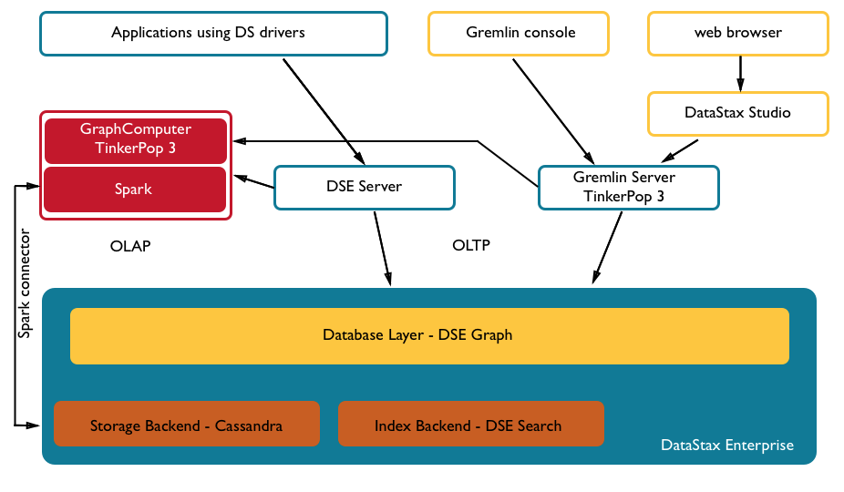
Determine the most effective viz
Idea Illustration
Notes:
Shows process or framework
Simple metaphorical
Used to simplify complexity
You are trying to convey ideas by boiling it down in representations

Slide 23
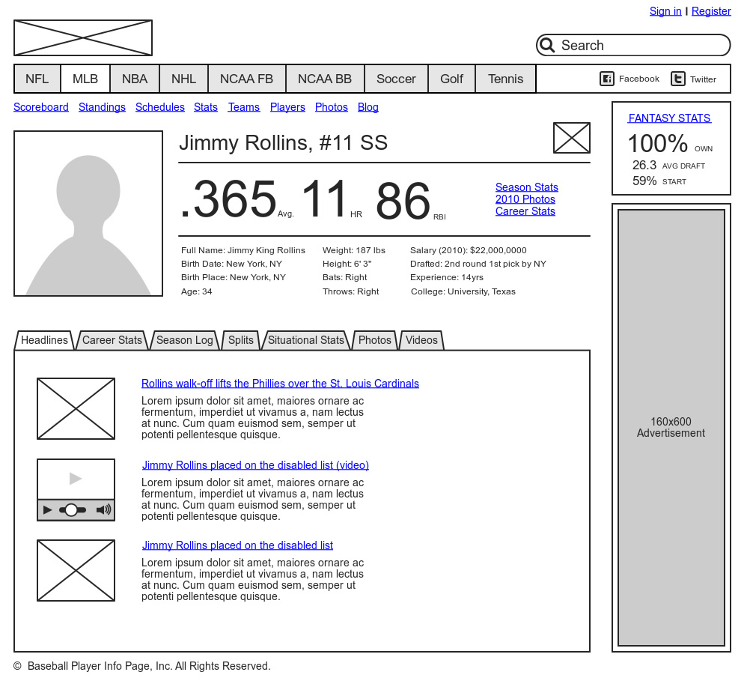
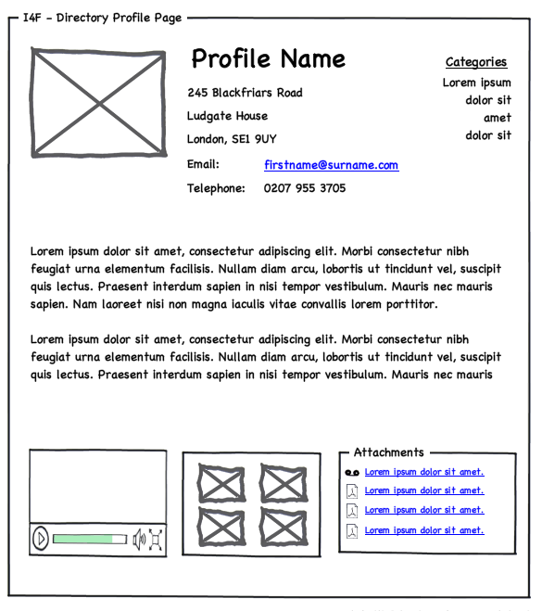
Determine the most effective viz
Idea Generation
Notes:
Validate ideas
Creative, free flowing
Used to wireframe / design
When designing screens, for example, a quick sketch gets right to the point, it’s often worth a 1000 words

Slide 24
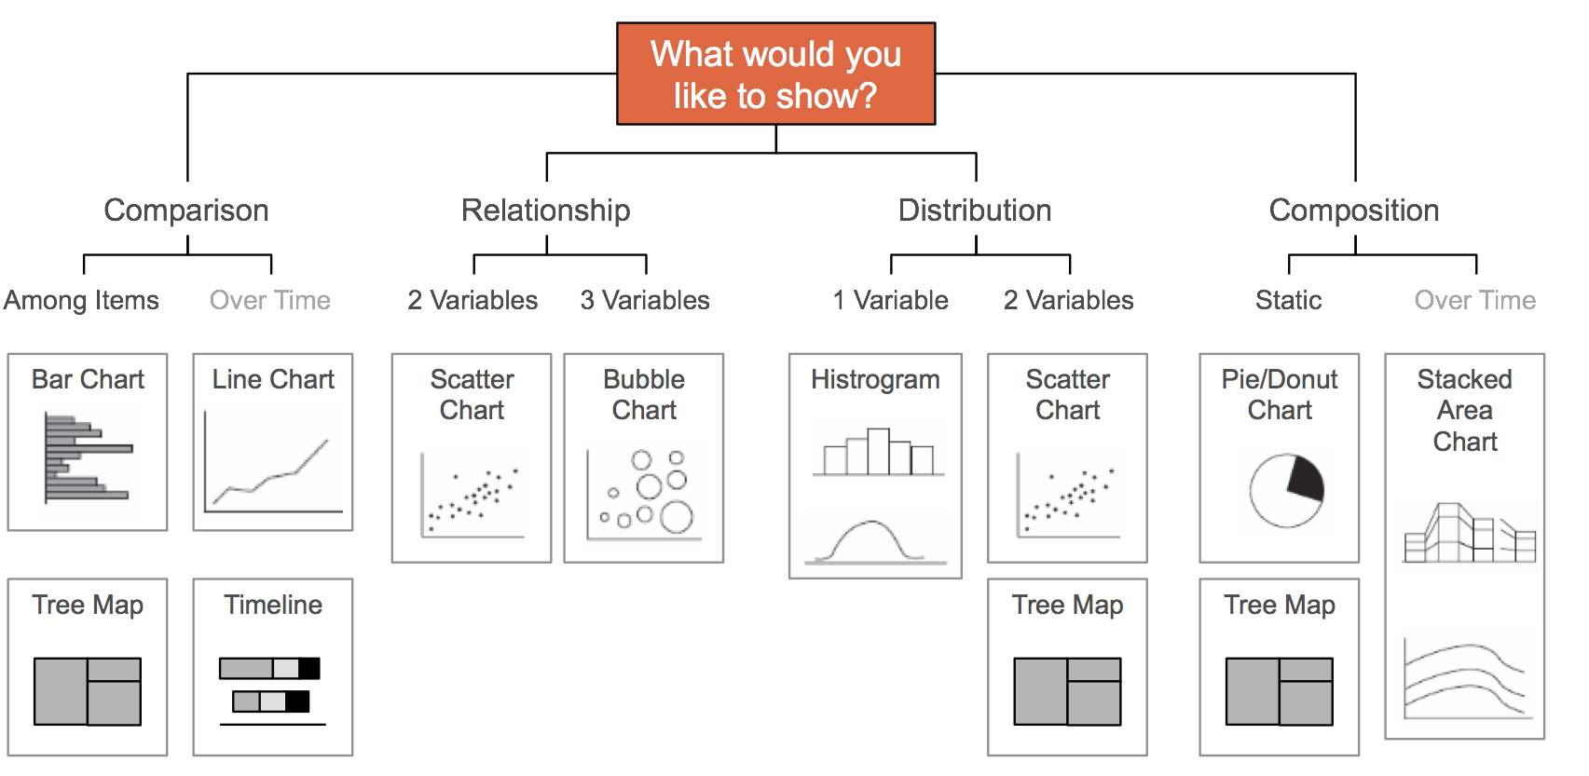
Determine the most effective viz
Standard visualization
Andrew Abela:
http://extremepresentation.com/
Notes:
There are standard ways to lead you to the path of the right standard visualization

Slide 25
Determine the most effective viz
Algorithm based graph stories
Dependencies
• Failure chains
• Order of operation
Clustering
Finding things closely related to each other (friends, fraud)
Similarity
Similar paths or patterns
Matching / Categorizing
Highlight variant of dependencies
Flow / Cost
Find distribution
problems, efficiencies
Centrality, Search
Which nodes are the most connected or relevant
Notes:
Creating tools for data Exploration gets very tricky
Graph is more complicated but some common algorithms give us hints
I’ll show an example a little later on about centrality (basically influence) <- we’re going to concentrate here because it is a complex data exploration example

Slide 26
User Perspective
What users think will bridge the gap.
Why, how and where your users do their work affects user adoption
Notes:
Remember this guy
A Note here about keeping the perspective of your users in mind:
How they do their work and their environment matters,
for example this guy is configuring a fiber optics network in the field.
He’s probably very interested in aspects of the graph data
but he’d be pretty unhappy traversing 250k vertices in an interactive node chart on that little touch screen

Slide 27
Example Scenario
Notes:
Let’s look at an example scenario on how to walk thru this process we’ve just outlined

Slide 28
Example Scenario - State the problem
Our users don’t have enough insight into how social media activity related to their products contribute to the bottom line, especially by region.
Notes:
Here is an example problem

Slide 29
Example Scenario - User Goals
Social media saturation
Quickly see information social media over time, by region, in relation to a specific product announcements. Identify key influencers.
Financial data correlation
Clearly correlate regional financial / sales data to a given region and announcement.
Overall performance of a product announcement at a glance
View regional, financial and social performance indicators for each announcements.
Notes:
So here are a few user goals related to that problem

Slide 30
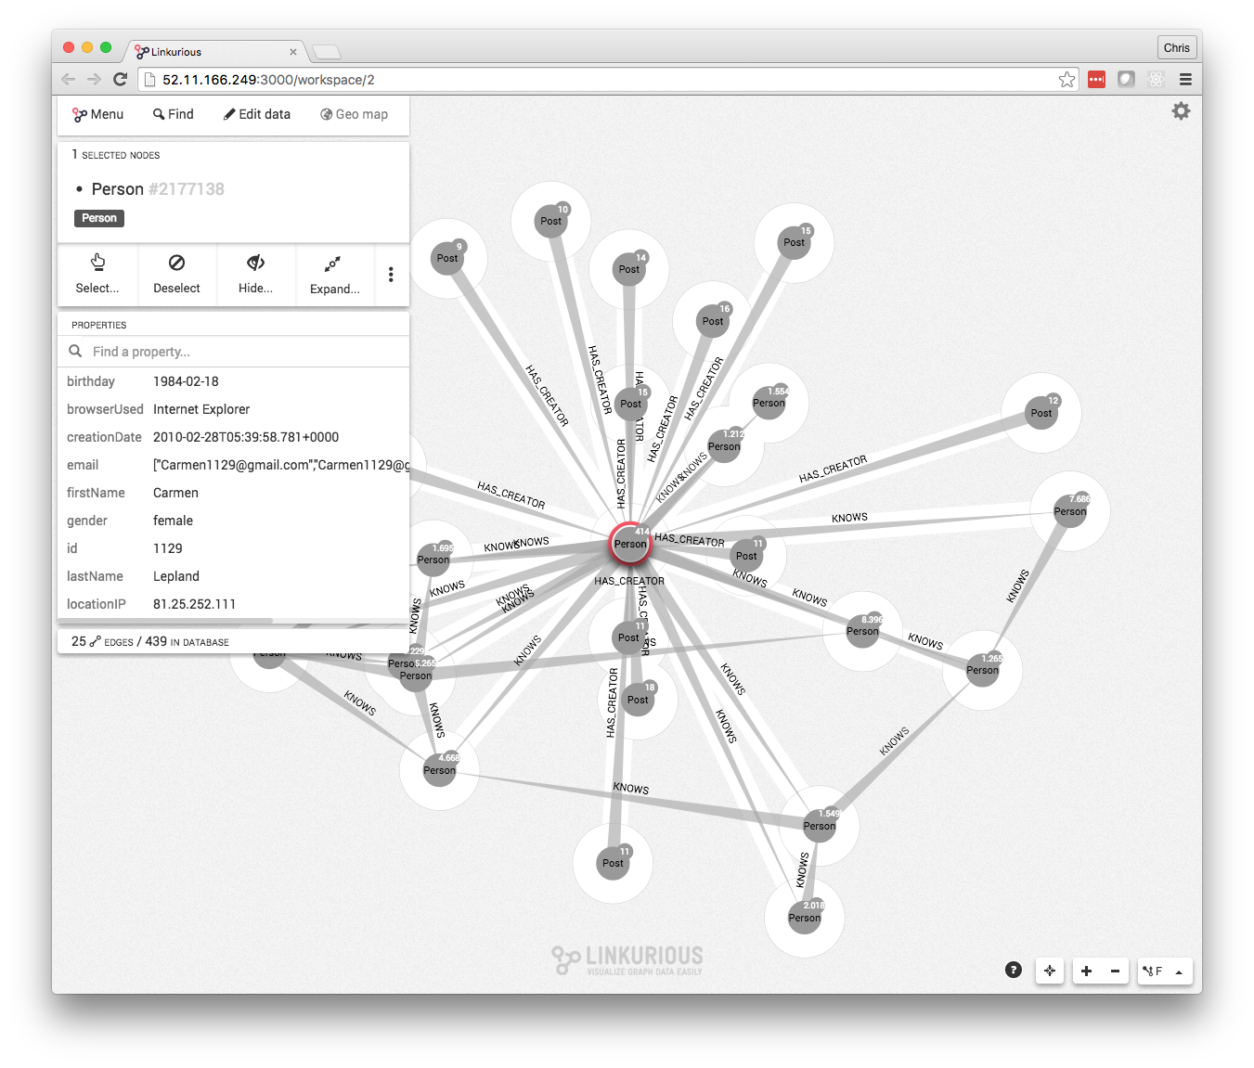
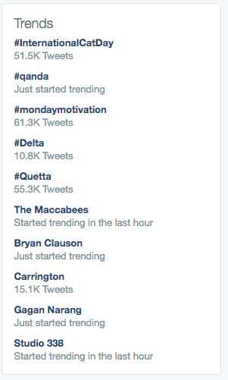
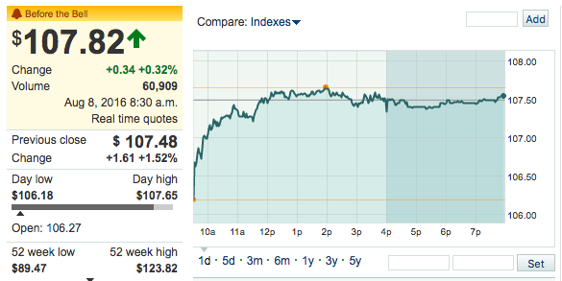
Example Scenario - Experience the data
Data Sources:
Graph of social media posts and comments
Regional sales and market data
Regional news announcements
Notes:
Once we know what our users want, we experience the data,
look at our social media activity in a graph (human interaction!),
look at financial numbers…
We look at product announcements
All over time and by region

Slide 31
Example Scenario - Experience the data
Dominant dimensions:
Product Announcements
Time
Region
Primary entities:
Social media occurrence (frequency) Financial KPI (sales / stock)
Notes:
So now we’ve got some data, How are we going to slice it to gain insights?
Well our user goals will tell us how,
what are they most interested, how do they want to filter and pivot

Slide 32
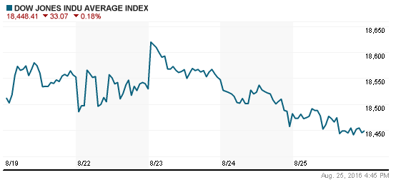
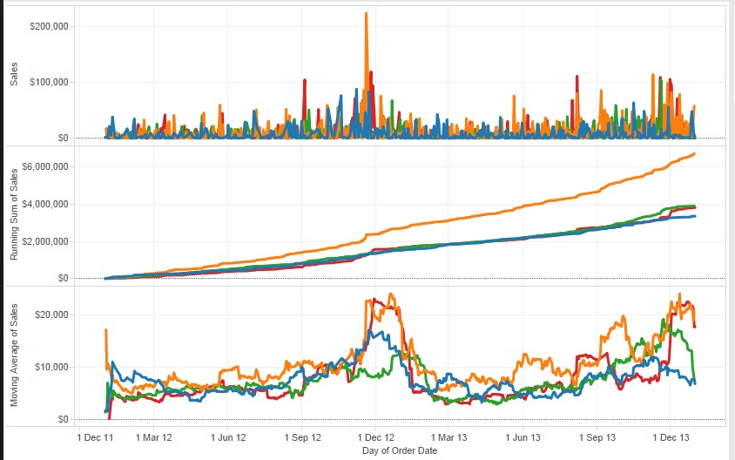
Example Scenario - Experience the data
What Does the data tell us?
Financial indicators and product order volume react inconsistently from region to region after traditional press announcements.
Sales are stronger in regions with more social media activity directly after a major announcement.
Notes:
What does it tell us:
Sales asymmetrical region to region
New product announcements are made at the region level
Social media indicates “stickiness” of those announcements through comments, retweets, posts, etc… in some regions
There is a correlation between social media activity and sales/finances

Slide 33
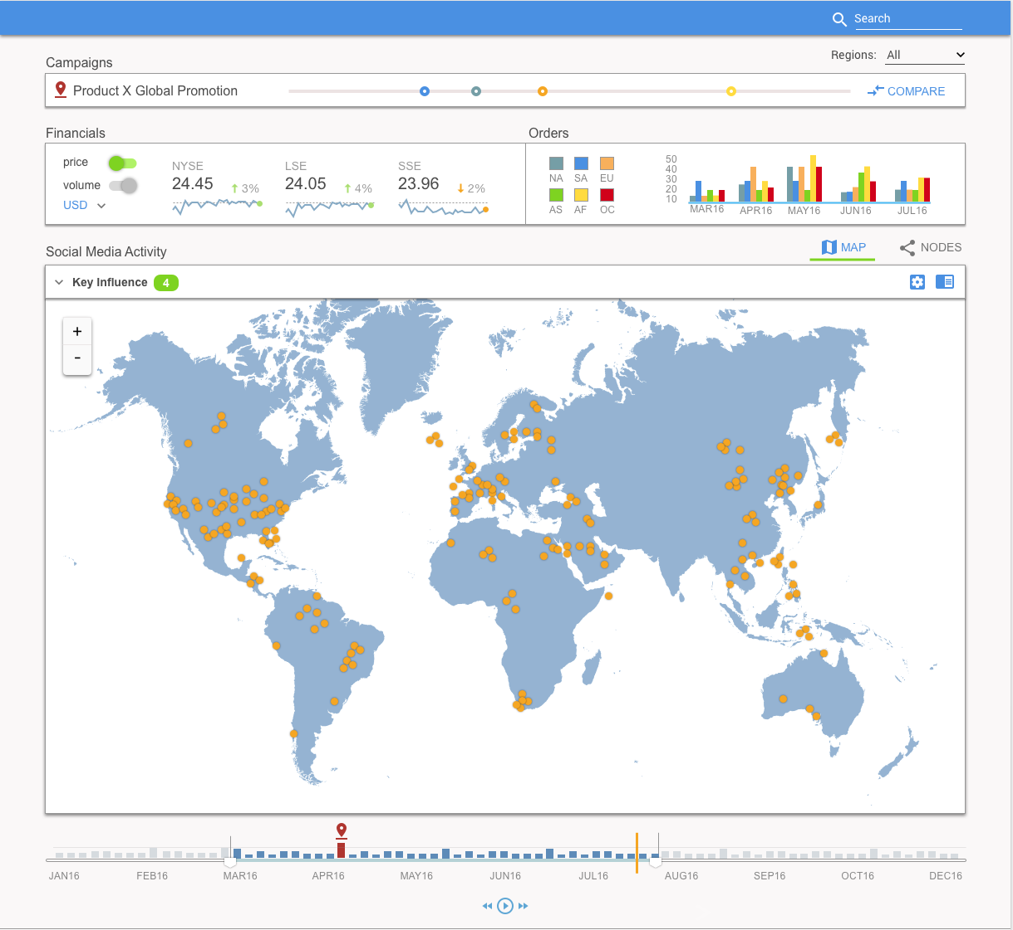
Example Scenario - Design Spec
Dominant dimensions
Product Campaign
Region
Time
Notes:
Here is an example design spec, note we’ve retained the dominant dimensions as navigation points in our information architecture

Slide 34
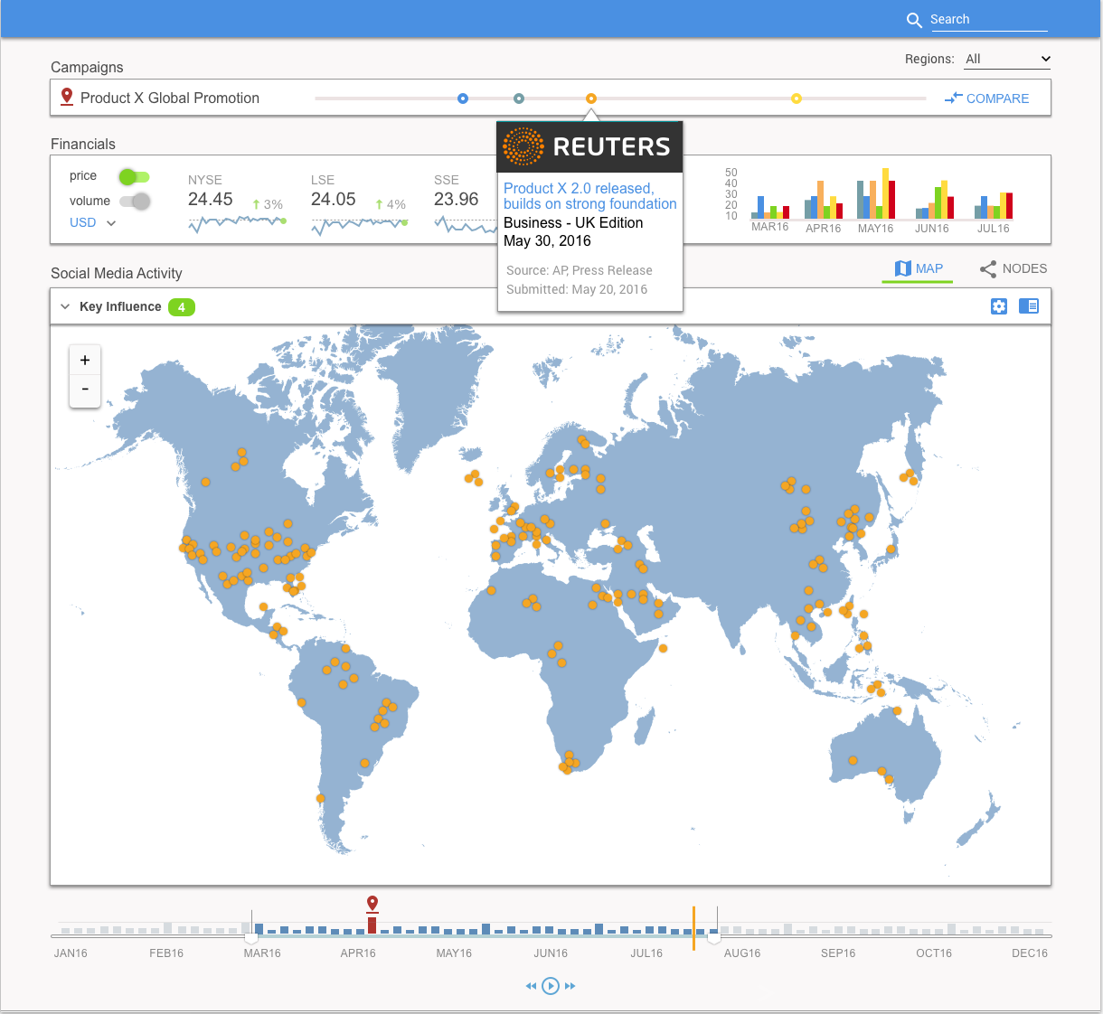
Example Scenario - Design Spec
Primary Entities
News Story
Financial KPIs
Social media occurrence
Notes:
And here are our primary entities, both in standard visualization
as well as exploratory data analysis,
in this case, geospatial occurrences of social media activity

Slide 35
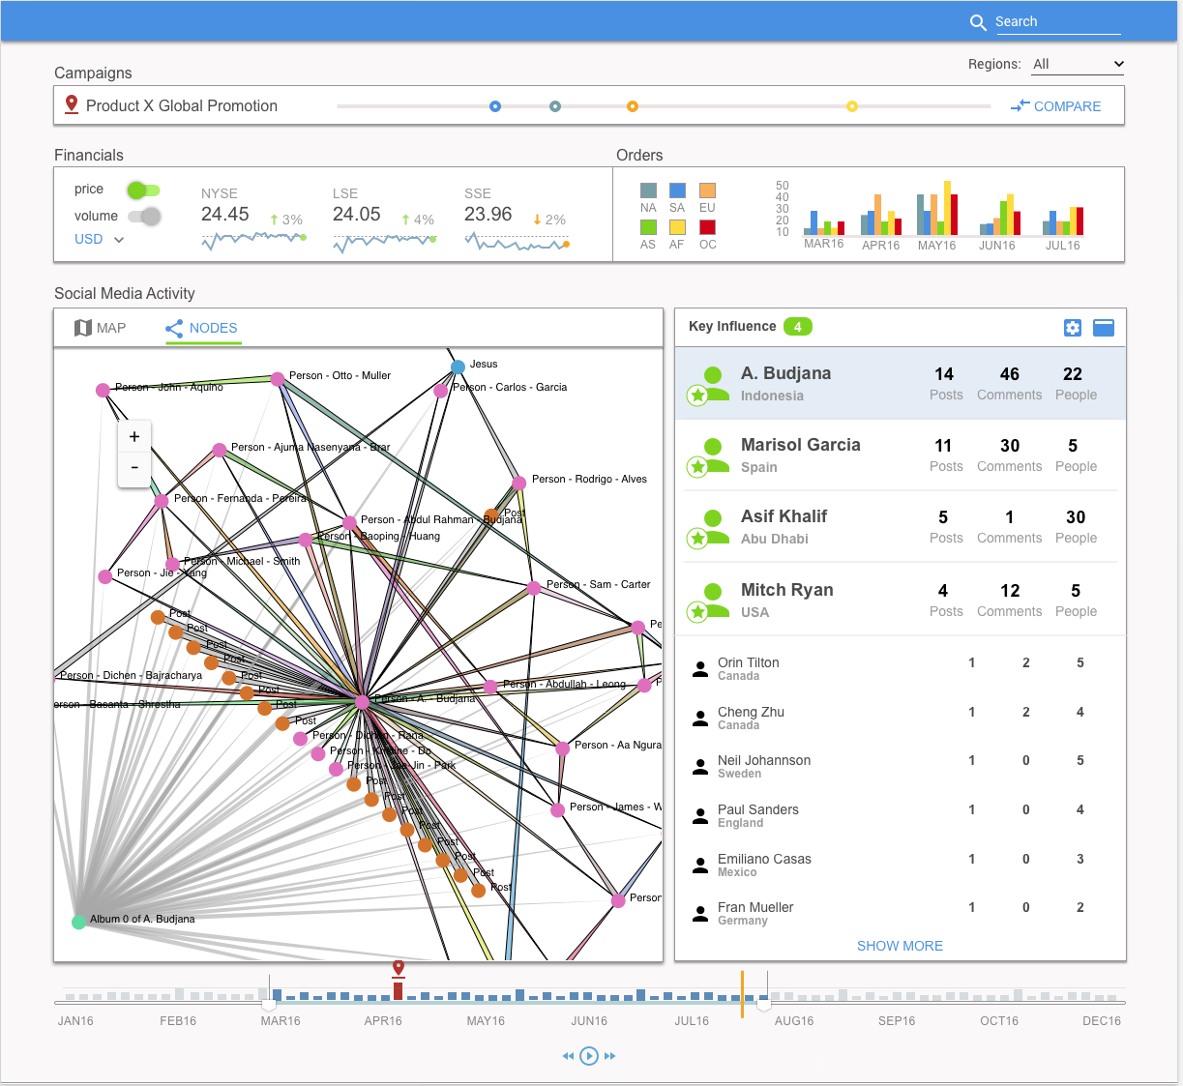
Example Scenario - Design Spec
Goals
Social media mention patterns, regionally, over time
Identify key influencers in social media, and announcement origin (per region)
2
Key Influence Indicators
Using weighted criteria, the user can zero in on key influencers within a given region at the selected time
The User can progressively disclose more information about that activity by selecting one of the influencers.
2
Notes:
A bit of a more detailed version of the spec,
this shows a drill in on a node chart to identify regional key influencers in social media (centrality algorithm, those with the most connections)

Slide 36
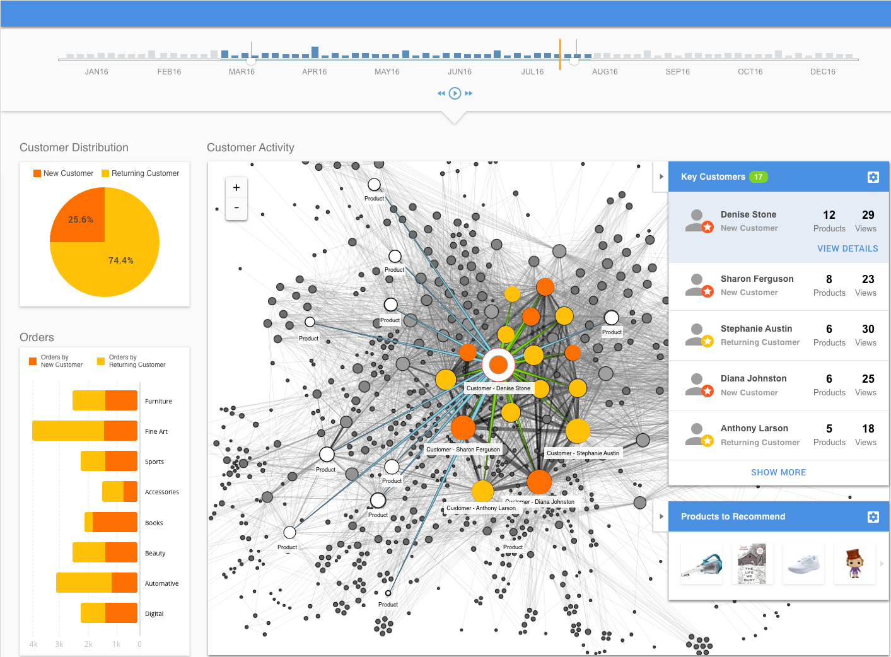
Example Scenario - Design Spec
Notes:
And a couple more related design examples, related to a customer 360 view in the retail space
this one is also a centrality algorithm,
interspliced with standard visualizations to show data correlation on our dominant dimensions

Slide 37
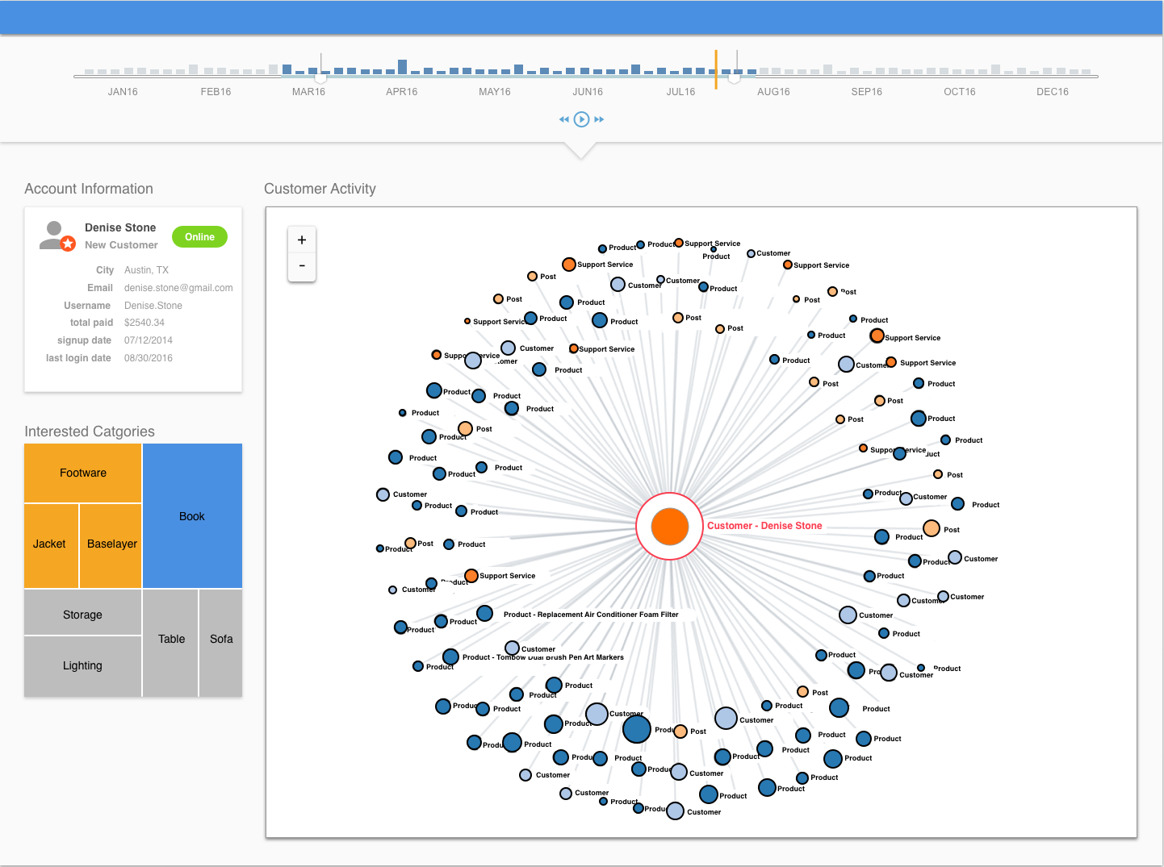
Example Scenario - Design Spec
Notes:
And a drill down view of the same example

Slide 38
Choosing The Tools
Enumerate needs based on spec
Evaluate off-the-shelf, open source, custom
Ensure UX is cohesive
Notes:
Disclaimer, this is going to be from a web-based delivery perspective, it’s what i know
Dig thru the spec to enumerate the charts, level of interactivity and ui widgets you need
Look at libraries already out there, there are a ton of good things
Make sure everything fits together, frankenstein UIs are hard to use and maintain

Slide 39
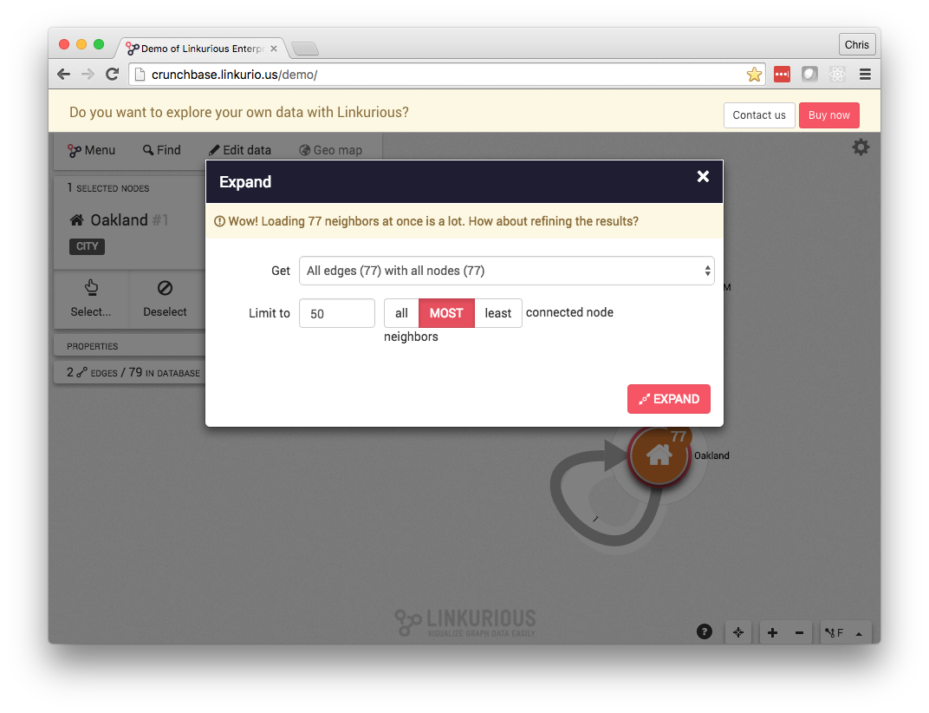
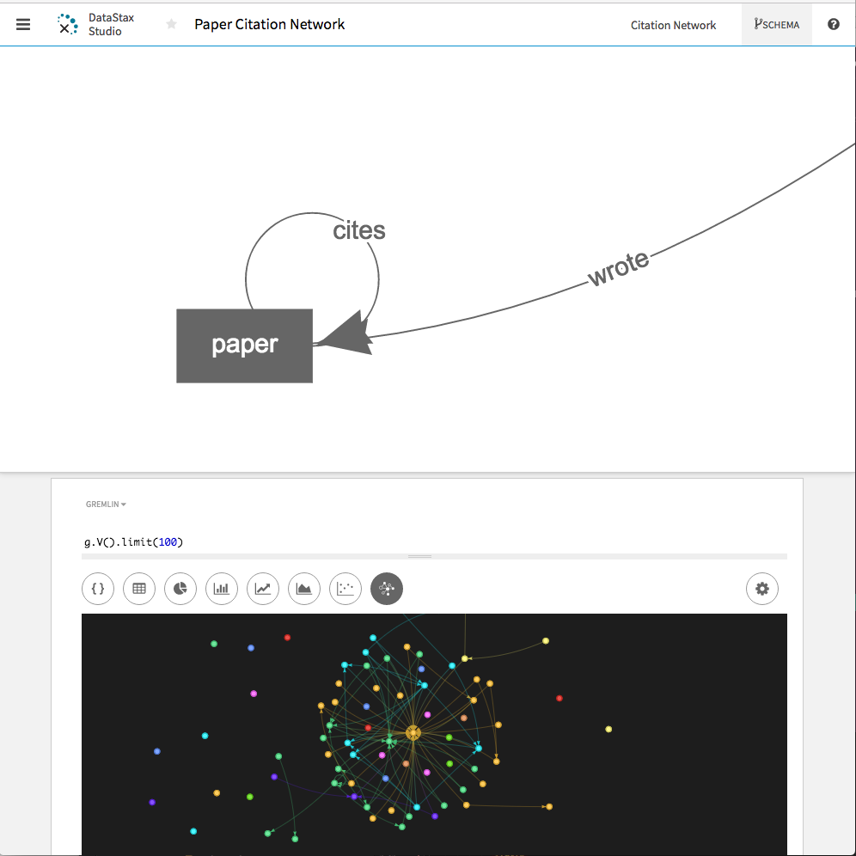
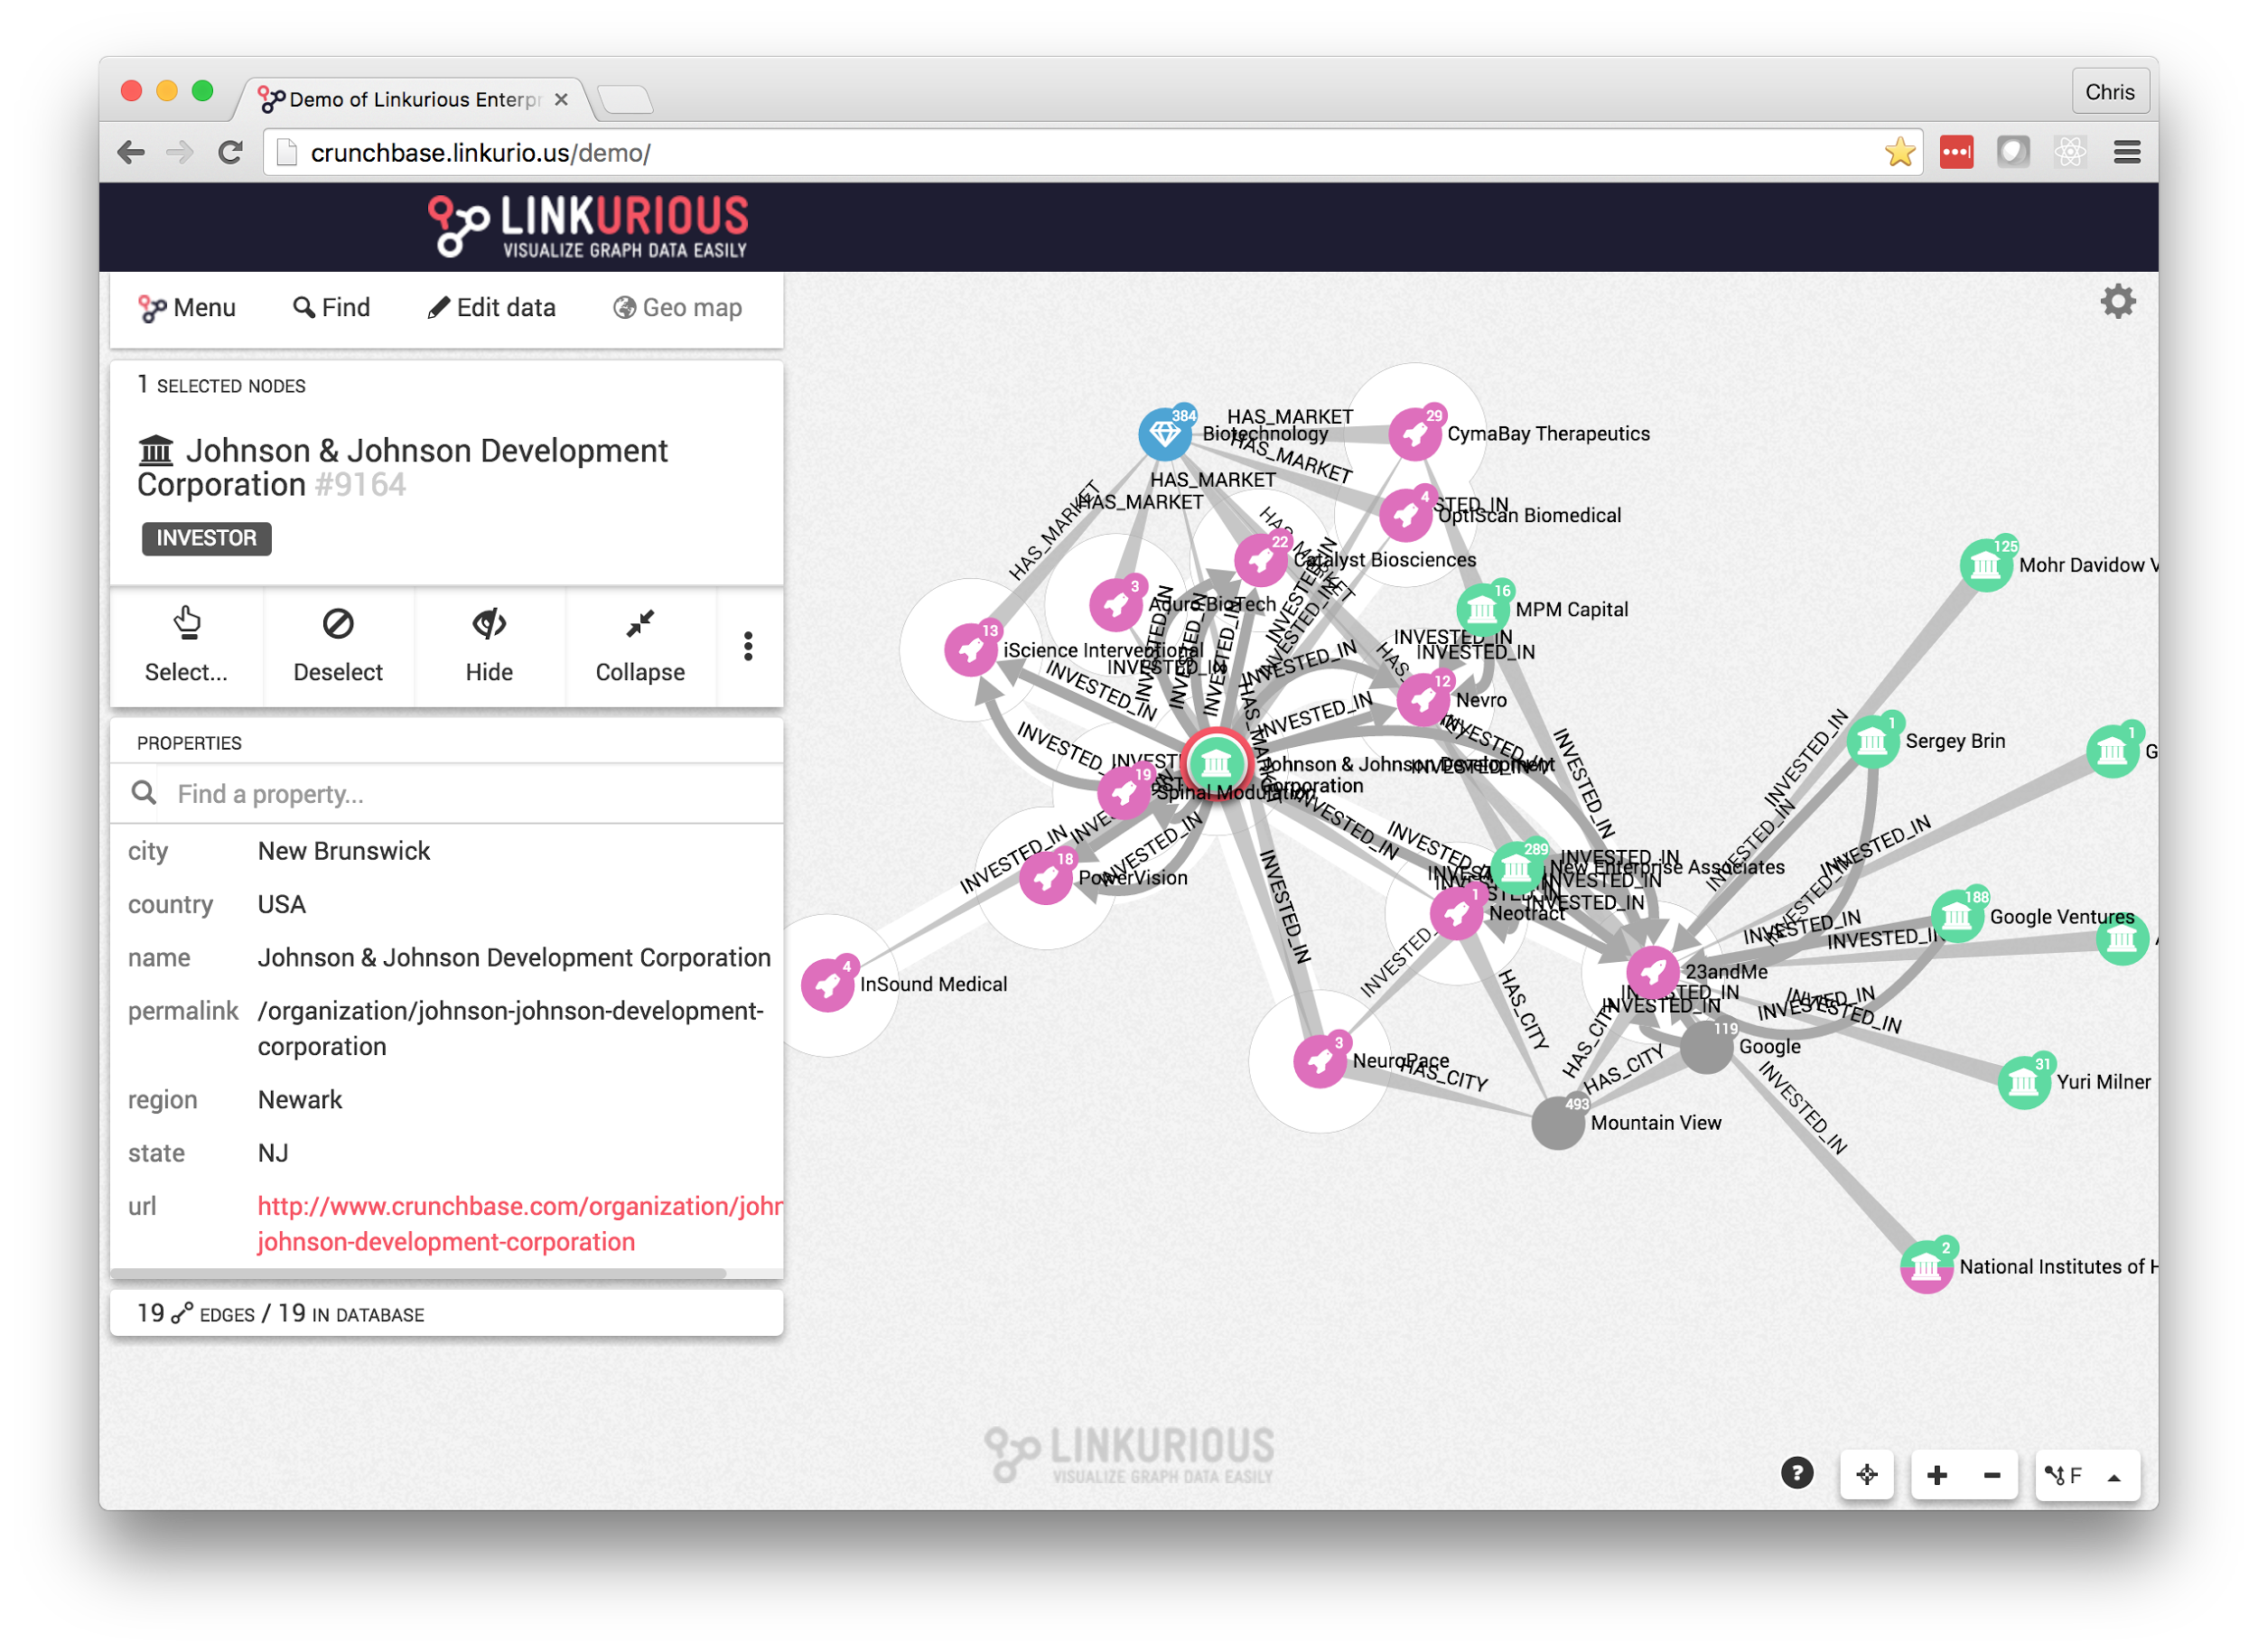
Experiencing the data
DataStax Studio
Linkurious Enterprise
Notes:
Stand up your data to experience it in the most expedient way possible, don’t write a ton of code if you can avoid it.
There are products like Linkurious Enterprise that do this, your database package may also have pretty powerful tools
This might be all you need

Slide 40




UI Frameworks and Libraries
Selecting a robust framework offers:
A better, more consistent UX
Faster development
Browser compatibility support
Responsive UI extensions
A methodology
Notes:
Modern UI Frameworks and libraries make things easier, faster and more cohesive
They keep your designers and developers on the rails with best practices

Slide 41
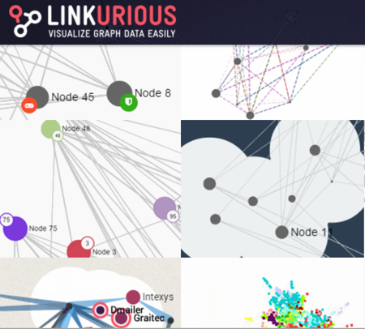
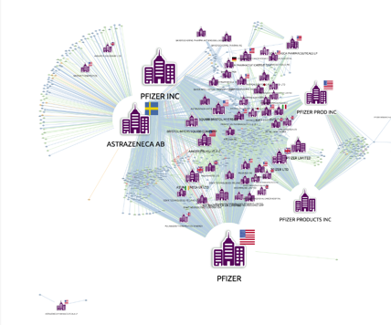
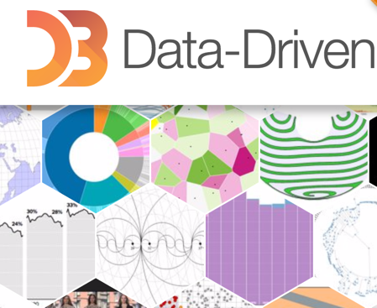

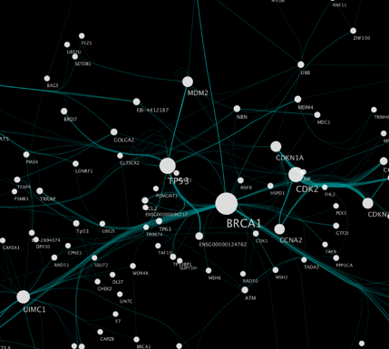
Node Chart Visualizations
LinkuriousJS
KeyLines
D3
Sigmajs
Cytoscape
Notes:
There are tons of things out there to quickly stand up a performant, interactive node chart in a custom application

Slide 42
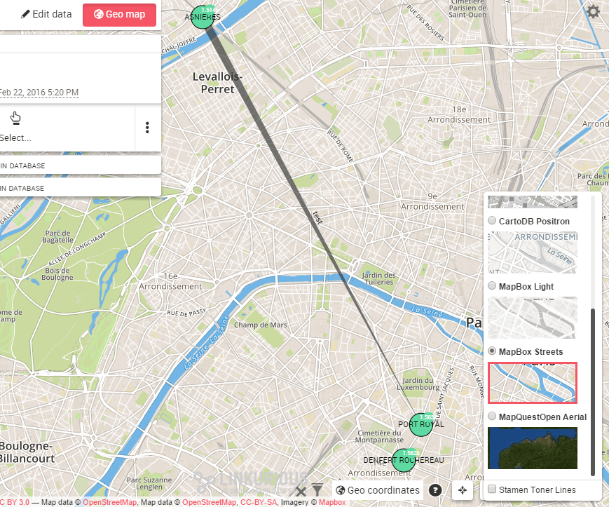
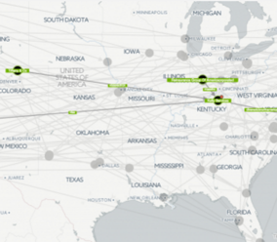
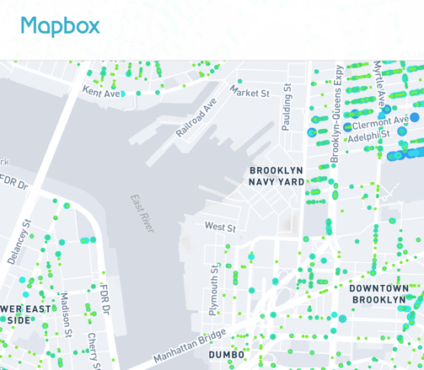
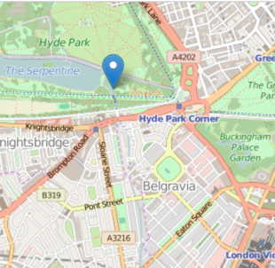
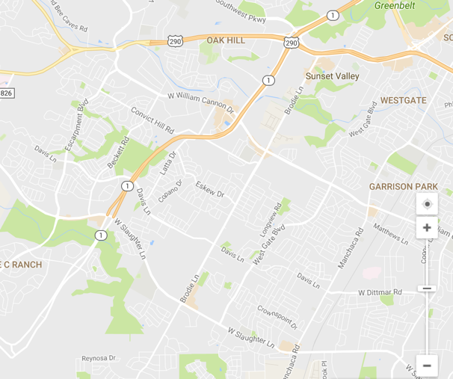
Geospatial
LinkuriousJS
KeyLines
Mapbox
LeafletJS
Google Maps
Notes:
Same can be said for map products

Slide 43
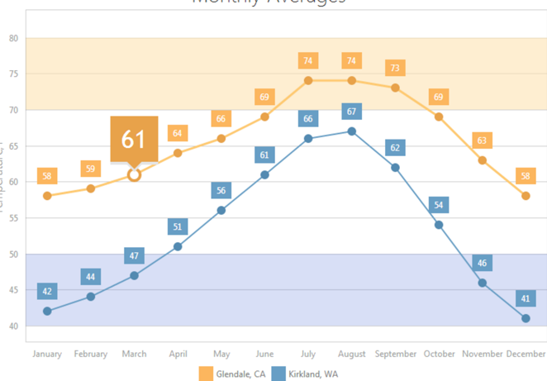
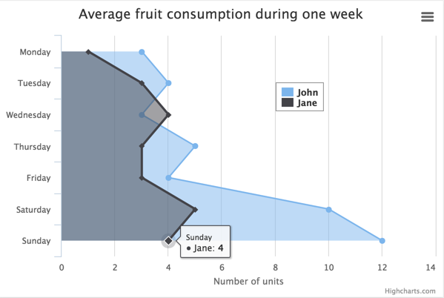
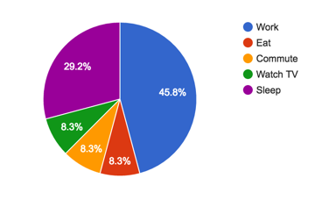
Standard Visualizations
ChartJS
Highcharts
Google Charts
Notes:
A good, lightweight charting option will drop into most frameworks

Slide 44
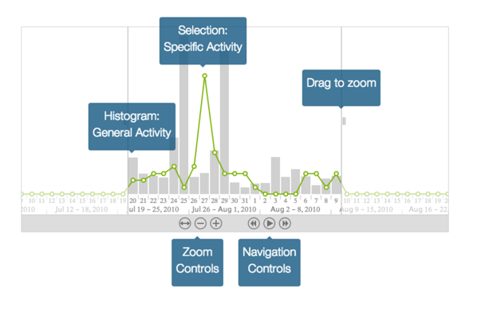
Timebar
KeyLines
Notes:
Time series widgets are complex, the folks at Keylines have put together a very powerful one that integrates with their other graph based widgets

Slide 45


Thank you
FOLLOW US
@ExperoUX
@uxchrislacava
EMAIL US
email@experoinc.com
chris.lacava@experoinc.com
Notes:
Happy to answer any questions, feel free to reach out to me directly
Thanks so much for your time, good luck with all your graph projects!

